Slide 1

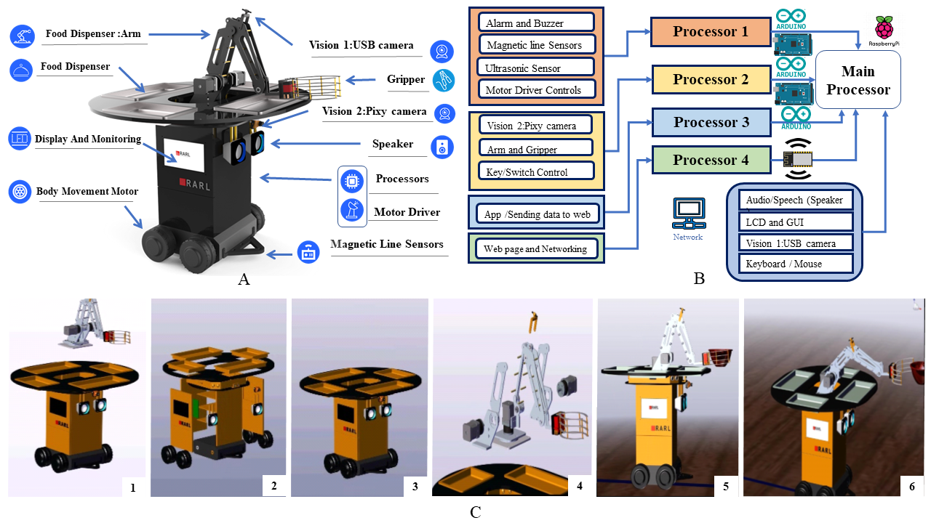
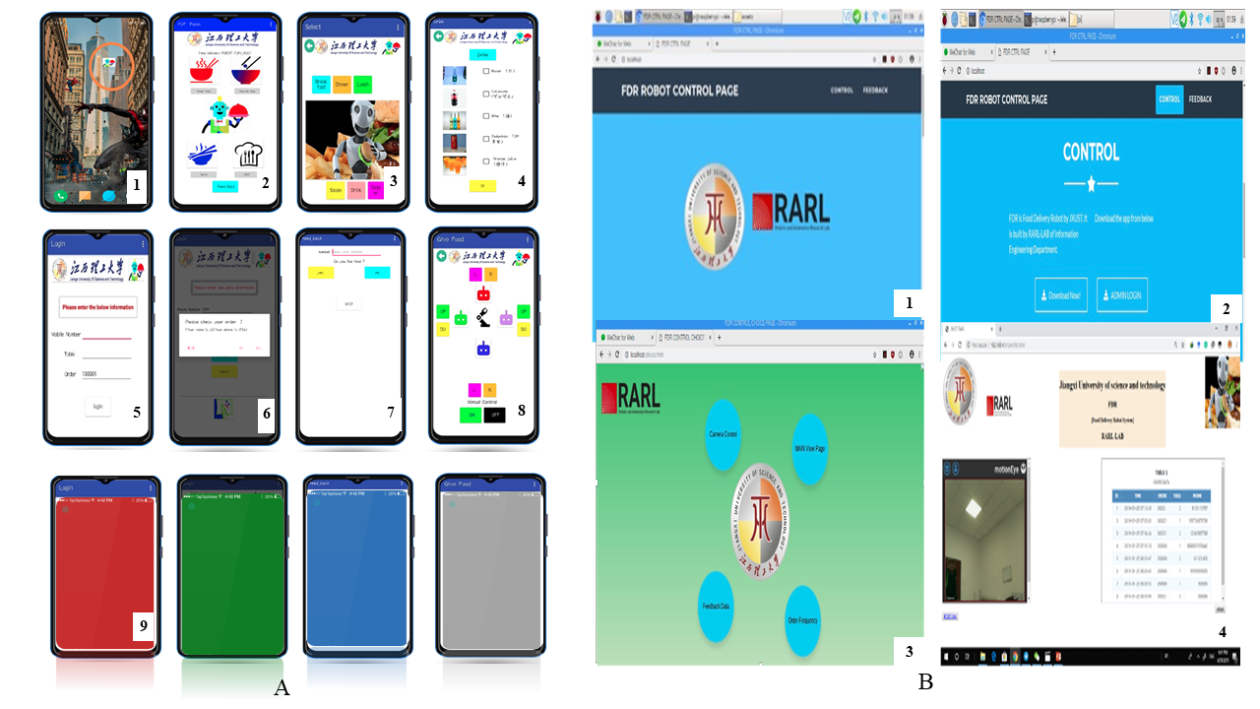
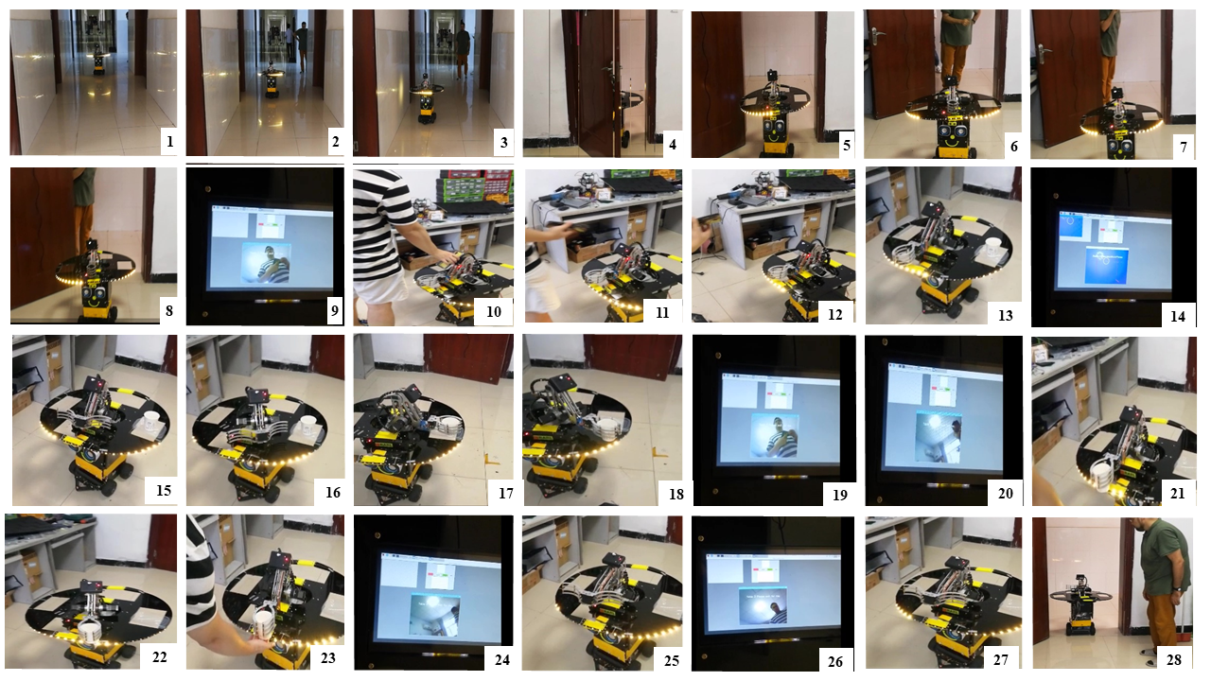
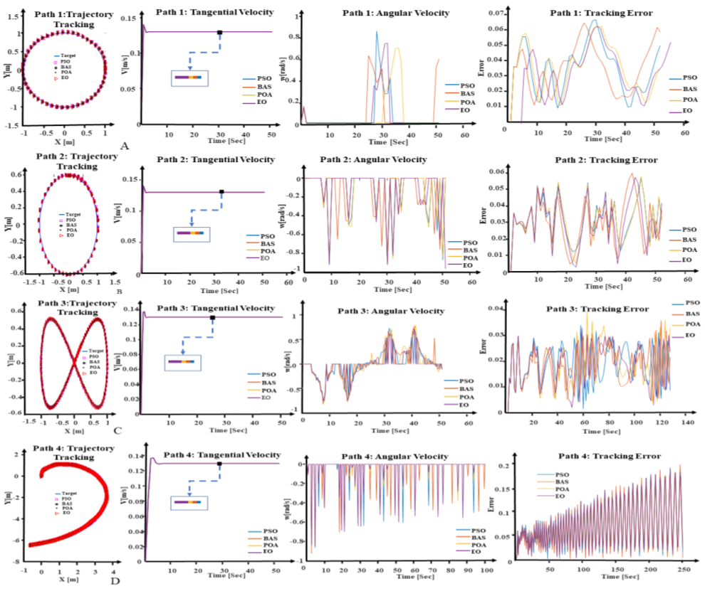
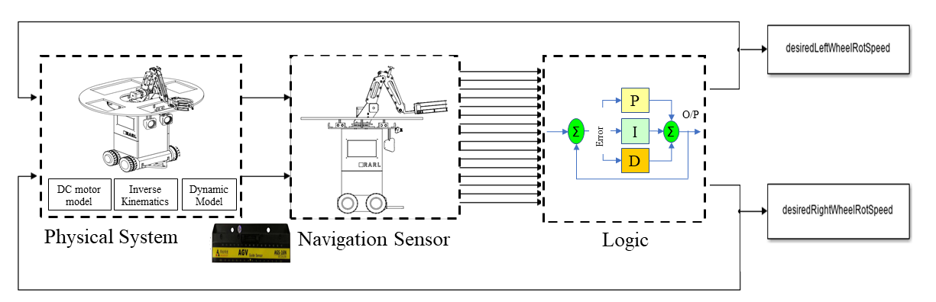
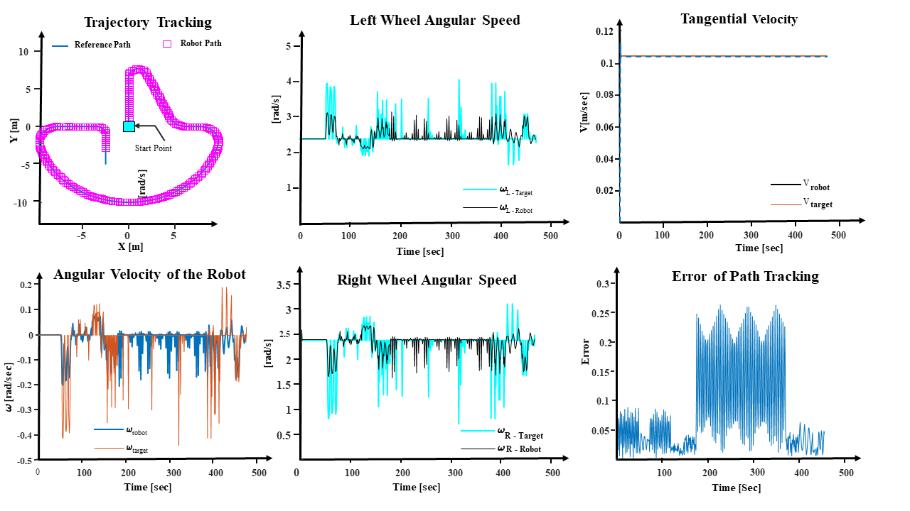




FOODIT
食品配送机器人：从仿真到设计与性能
INTRODUCTION
FOODIT 机器人是一个综合系统，集成了硬件（各种传感器）和软件（移动应用程序和网络应用程序），以执行导航路径、下单、识别个人和送餐等任务。
A. 机器人硬件系统
结构：
机器人配备四个车轮（4WD）和一个具有四自由度（4 DOF）的机械臂。Vision Camera 1用于用户输入，Pixy Camera 2用于用户验证。
组件：
主要组件包括车身移动马达、用户交互、处理器、传感器、食品分配器和电源键。
处理器：
系统使用三个CPU（Raspberry Pi、Arduino Mega和WeMo's）进行多任务处理和高效协调。处理器1负责移动和避障，处理器2管理Pixy Cam和机械臂，处理器3连接移动应用程序和网页。Raspberry Pi作为主处理器和通信枢纽。
B. 机器人软件系统
移动应用程序：使用MIT App Inventor开发，包含以下功能：
Login Page: 用户认证。.
Order Pages: 食物选择和反馈。
User Selection Data Page: 显示已选择的食物项目并为送餐分配颜色代码。.
SETINPAGE Procedure: 建立与WEMOS板的连接，用于Web服务器设置。
Robot Control Procedure: 通过Web界面管理机器人的操作。
DATAUPDATE Procedure: 使用JSON格式将数据上传到服务器。
Web Application: 通过以下页面增强系统管理：应用程序下载、摄像头控制、主视图、反馈、订单管理和数据导出。MySQL数据库管理用户订单和反馈。连接到树莓派的由Arduino控制的USB摄像头捕捉并上传图像，促进食物准备和送达。
CONCLUSIONS
在本研究中，讨论了名为FOODIT的服务机器人设计和仿真。与商业化模型不同，FOODIT具有独特的特点，包括经济实惠的价格和运输四道菜的能力，增强了现有模型的送餐能力。该机器人可以与多个平台集成，具有简化操作的简单路由系统。通过移动应用程序，客户可以评估服务和食品质量，并进行实时环境监控。在MATLAB仿真中，包括初始PID控制器参数设置，并通过四种优化方法（BAS、PSO、POA和EO）在四条路径（圆形、椭圆形、螺旋形和八字形路径）上评估机器人的性能。EO方法在第三条路径上显示出最高的准确性（R = 0.99995），而BAS方法在第一条路径上表现最佳（R = 0.999988）。每种优化方法在不同的路径上都达到了最高速度，且BAS方法在执行时间上普遍优于其他方法。研究结果表明，优化方法的选择对准确性和速度结果有显著影响，但优异的结果并不总是与最大数量的粒子和重复次数相关。PSO方法在第一、第三和第四条路径上达到了最高速度，而POA在第二条路径上表现最佳。机器人的性能与优化后的PID控制器系数证实了仿真的准确性。然而，当前设计的一个主要限制是由于机械臂操作导致的两分钟送餐速度。未来的发展将重点优化送餐过程，并评估将设计集成到群体格式中的可能性，这标志着系统改进和创新功能的重要进展。
Published result
Moshayedi, A. J., Roy, A. S., Liao, L., Khan, A. S., Kolahdooz, A., & Eftekhari, A. (2024). Design and Development of FOODIEBOT Robot: From Simulation to Design. IEEE Access.

Slide 2
FOODIT
FOOD Delivery Robot: From Simulation to Design & Performance
INTRODUCTION
The FOODIT robot is a comprehensive system that integrates hardware (various sensors) and software (Mobile App and Web Application) to perform tasks such as navigating paths, placing food orders, identifying individuals, and delivering food.
A. Robot Hardware System
Structure: The robot features four wheels (4WD) and a 4 DOF robotic arm with Vision Camera 1 for user input and Pixy Camera 2 for user verification.
Components: The main components include the body movement motor, user interaction, processor, sensors, food dispenser, and power key.
Processors: Three CPUs (Raspberry Pi, Arduino Mega, and WeMo’s) are used for multitasking and efficient coordination. Processor 1 handles movement and obstacle avoidance, Processor 2 manages Pixy Cam and robotic arm, and Processor 3 connects the mobile app to the web page. The Raspberry Pi acts as the main processor and communication hub.
B. Robot Software System
Mobile Application: Developed with MIT App Inventor, it includes:
Login Page: User authentication.
Order Pages: Food selection and feedback.
User Selection Data Page: Displays chosen food items and assigns a color code for delivery.
SETINPAGE Procedure: Establishes connection with WEMOS board for web server setup.
Robot Control Procedure: Manages robot operations via web interface.
DATAUPDATE Procedure: Uploads data to a server using JSON format.
Web Application: Enhances system management with pages for app download, camera control, main view, feedback, order management, and data export. The MySQL database manages user orders and feedback. An Arduino-controlled USB camera connected to the Raspberry Pi captures and uploads images, facilitating food preparation and delivery.
CONCLUSIONS
In this research, the design and simulation of a service robot named FOODIT are discussed. Unlike commercial models, FOODIT offers distinctive features, including economical pricing and the ability to transport four dishes, enhancing delivery capabilities compared to existing models. The robot integrates with multiple platforms and features a straightforward routing system, simplifying operations. Customer interaction is facilitated through a mobile application for assessing service and food quality and real-time environmental monitoring.The MATLAB simulation included initial PID controller parameter settings, and the robot's performance was evaluated using four optimization methods: BAS, PSO, POA, and EO, across four paths: Circle Shape, Ellipse Shape, Spiral Path, and Eight Shape Path. The EO method showed the highest accuracy (R = 0.99995) on the third path, while the BAS method excelled on the first path (R = 0.999988). Each optimization method achieved its peak speed on different paths, and the BAS method generally outperformed others in execution time. The findings highlighted that optimization method choice significantly impacts accuracy and speed outcomes, but superior results were not always tied to the largest number of particles and repetitions. The PSO method achieved the highest speed on the first, third, and fourth paths, while POA was the top performer on the second path.The robot's performance with the optimized PID controller coefficients confirmed the simulation's accuracy. However, a major limitation in the current design is the two-minute delivery speed due to arm operation. Future development will focus on optimizing the food delivery process and evaluating the integration of the design into a swarm format, marking significant progress toward system refinement and innovative functionality.
Published result
Moshayedi, A. J., Roy, A. S., Liao, L., Khan, A. S., Kolahdooz, A., & Eftekhari, A. (2024). Design and Development of FOODIEBOT Robot: From Simulation to Design. IEEE Access.

Slide 3

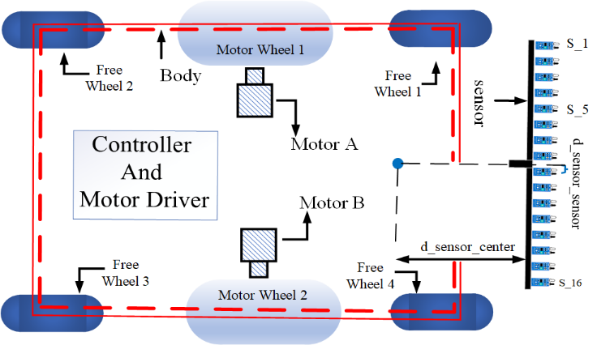
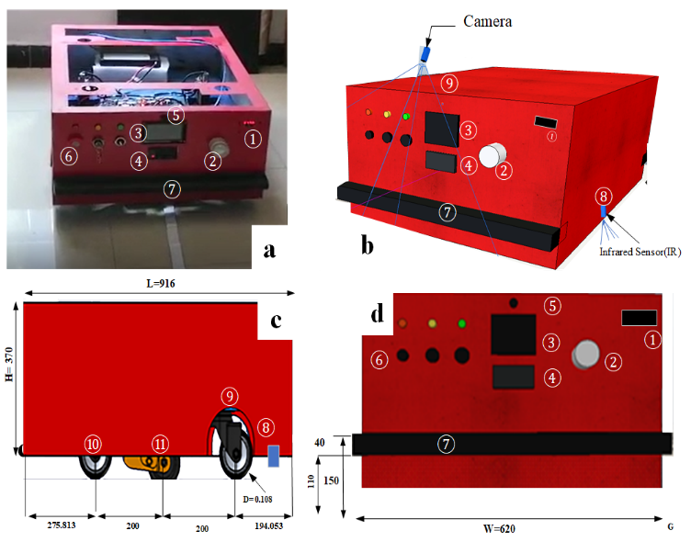
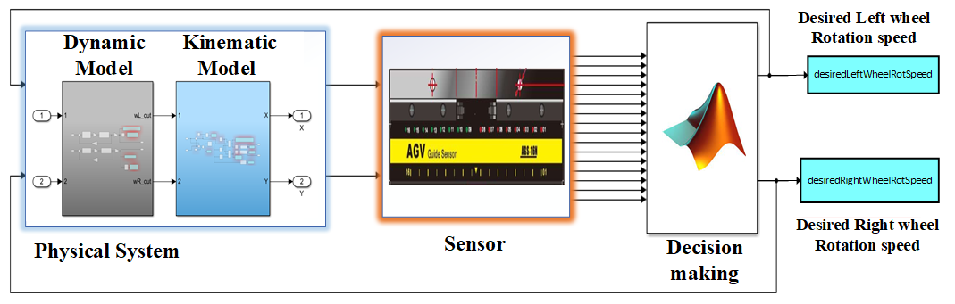
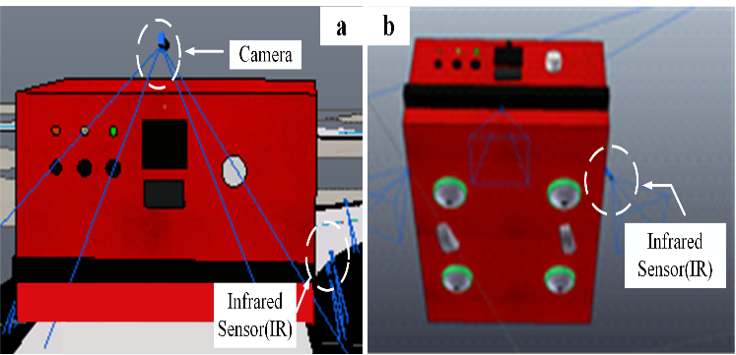
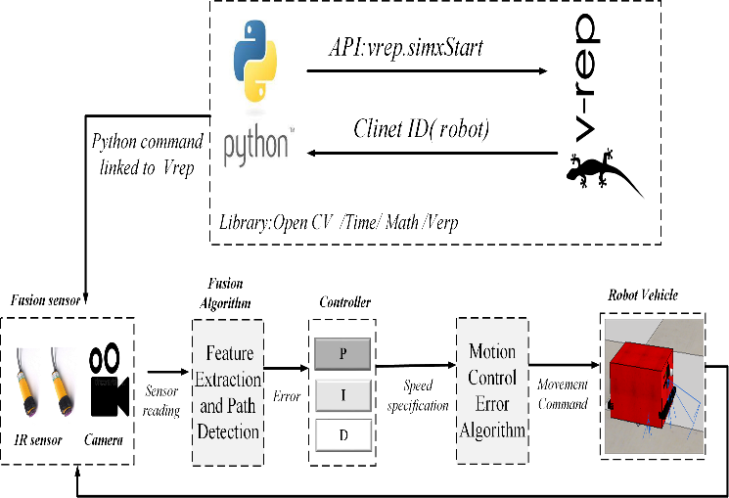
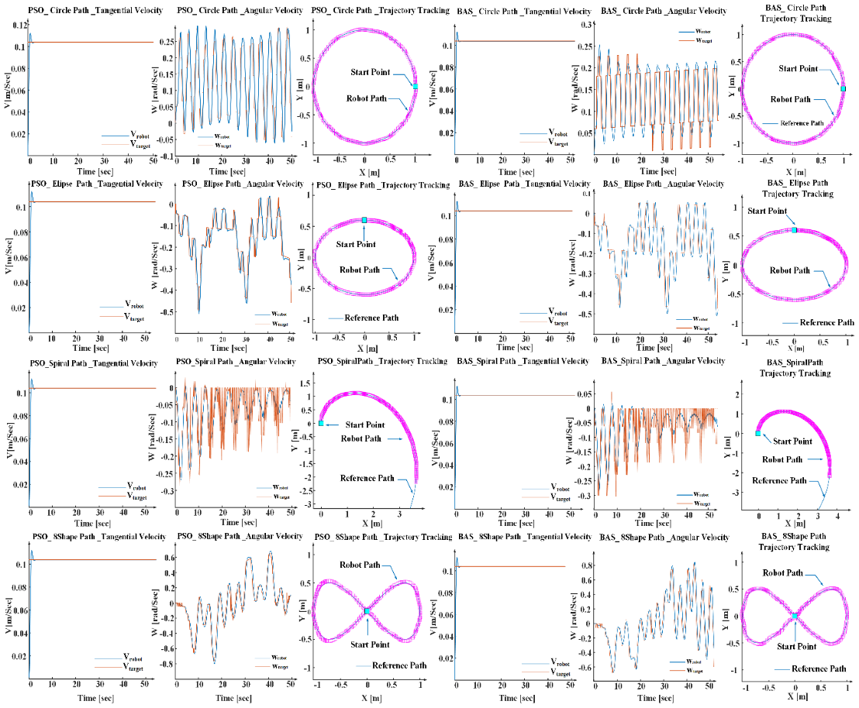
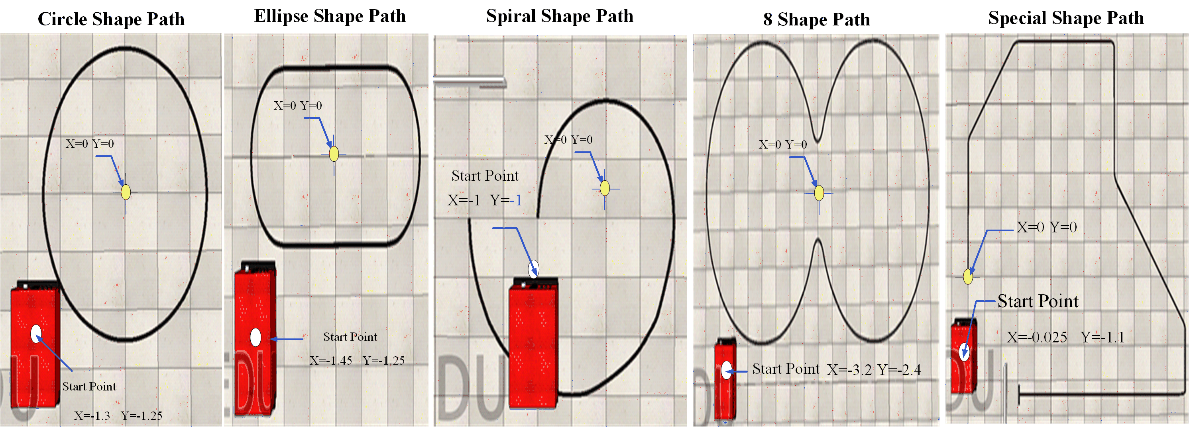
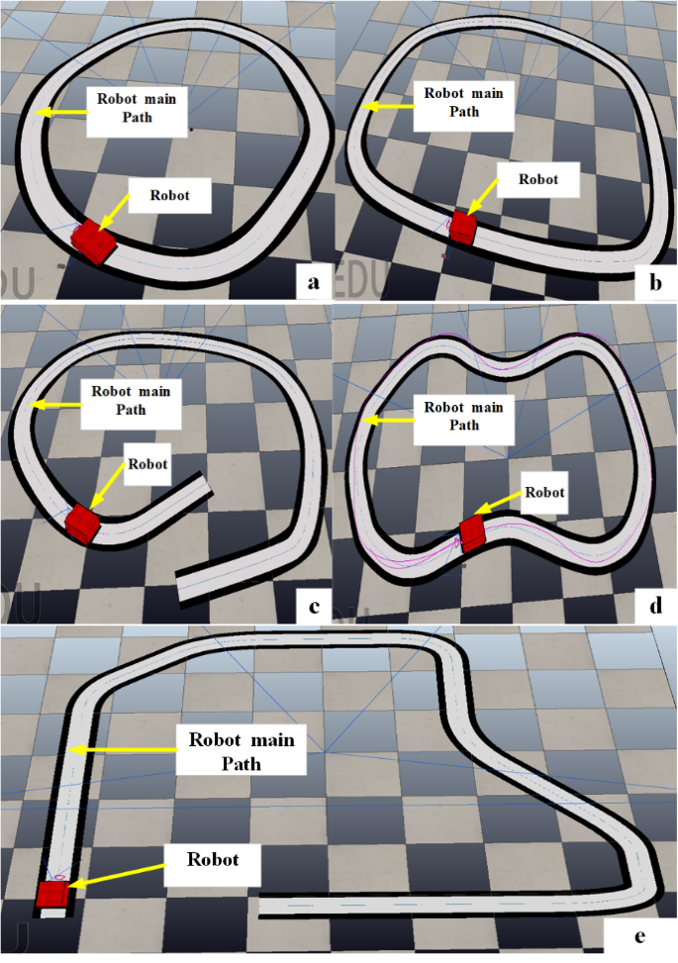
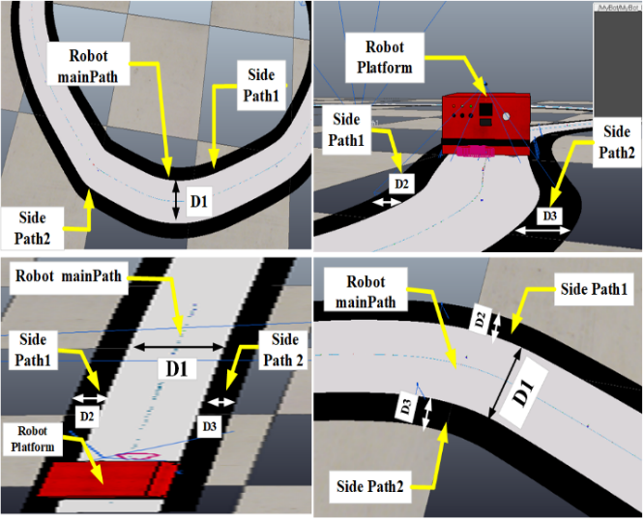
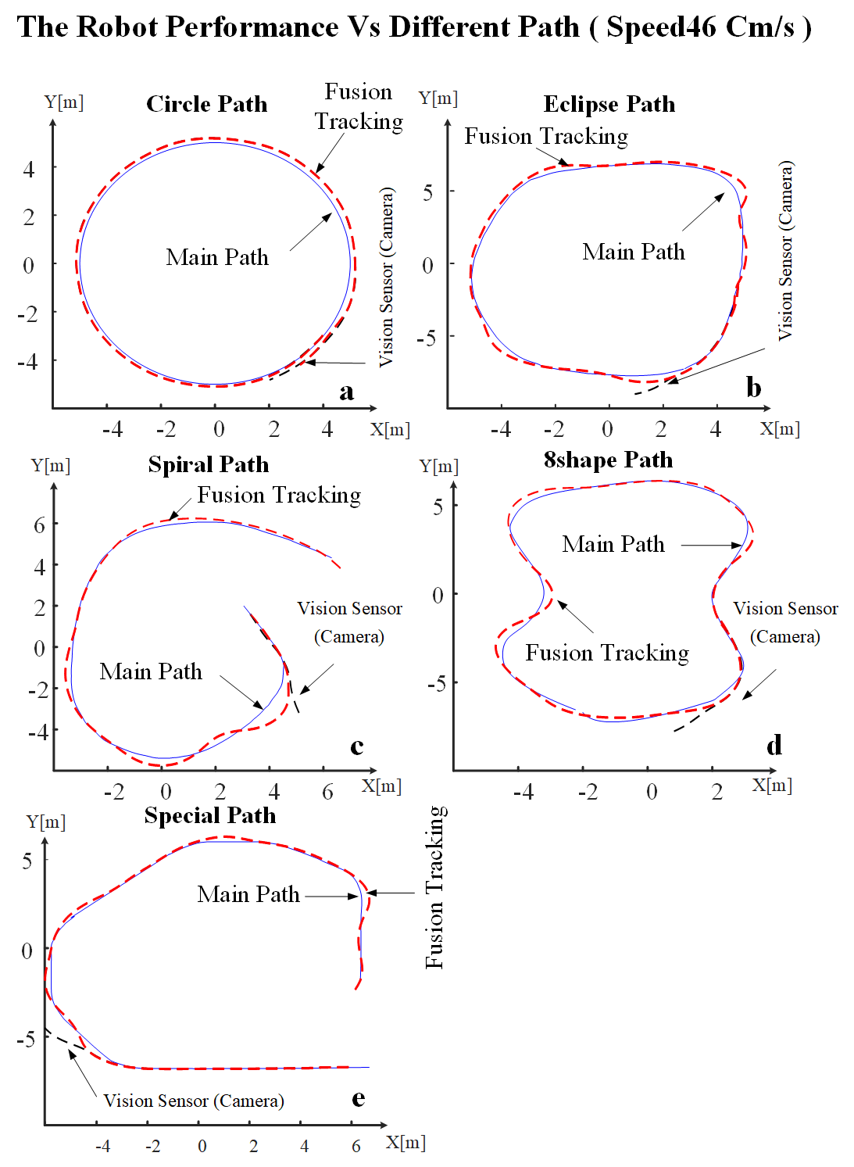
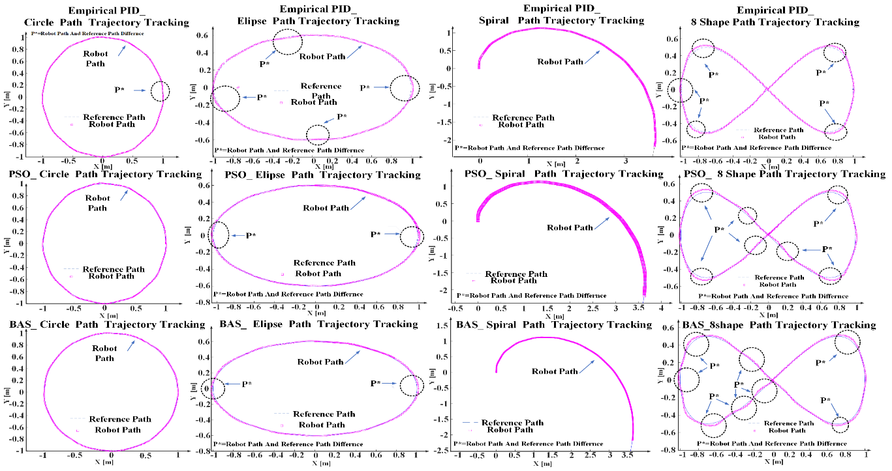


Hongma_ AGV Roobt
Service Robot: From Simulation to Design & Performance
INTRODUCTION
This Project explores the design and development of the AGV robot, named Hongma. The robot features two brushless motors positioned on the sides for propulsion and four free wheels to maintain balance.
Key components of the Hongma Design include:
LCD Screen: For displaying information.
Battery Charging Warning System: Alerts for battery status.
Ultrasonic Sensor: For distance measurement.
Stop/Start Adjustment Switches: Manual control of the robot.
The sensor configuration is as follows:
Bumper Sensors: Positioned at the front and back for collision detection.
Camera: Acts as the vision system with the following specifications:
Resolution: 256x256 pixels, Perspective Angle: 60 degrees
Clipping Plane: Near: 0.01 meters, Far: 0.9 meters
Sensor Size: 0.01 meters, Frame Rate: 30 fps
Position: Front of the robot, angled at 45 degrees.
Infrared Sensors (IR): Located on the right and left sides, each angled at 45 degrees.
Phase I Contributions:
1. Development of a Two-Wheel AGV Model : Proposed a detailed and effective model for a two-wheel AGV robot with four free wheels, utilizing Simulink for modeling and validating the extracted values through Vrep during trajectory missions.
2. Comparison with Previous Research : Compared the real dimensions and values of the AGV robot against those reported in previous research, highlighting the actual changes needed for PID controller tuning.
3. Performance Testing : Evaluated the robot’s performance on various paths (Circle, Ellipse, Spiral, 8-Shape, and a special path) of approximately 8 meters in length.
4. PID and Meta-Heuristic Algorithm Comparison : Introduced and compared the empirical PID method with two renowned meta-heuristic algorithms, Particle Swarm Optimization (PSO) and Bat Algorithm (BAS), for PID tuning.
Phase II Contributions:
1. Fusion Navigation Algorithm: Proposed a fusion navigation algorithm using a minimal number of sensors, enhancing navigation accuracy.
2. Vision System Comparison: Demonstrated the effects of the fusion algorithm in comparison to a vision-based system (Camera), assessing performance on the desired path versus the actual following path.
3. Speed Optimization: Determined the maximum feasible speed for both algorithms to achieve 100% successful tracking across five different paths and compared the performance results.
4. Real AGV Data Utilization: Utilized actual AGV dimensions and data, contrasting with prior research that often relied on smaller robot sizes.
AGV robot and explored PID value Vs path.
Robot performance vs PSO and BAS PID values in different Paths.
The five Experimental paths, a: circle: Elliptical, C: Spiral, D: 8 shapes, E: Special.
The experiment path dimension D1:main path,
D2 and D3: side path
The Robot Performance Vs Fusion and Vision Algorithms
The PID values with Empirical, PSO and BAS Vs robot path tracking.
CONCLUSIONS
This Phase 1 focuses on modeling and simulating a dual-wheeled AGV with 16 magnetic sensors and a PID controller using MATLAB. Key achievements include:
Model Development : Detailed AGV model construction, including parts and sensor integration.
PID Tuning: Used real AGV data for PID adjustment and compared empirical PID tuning with PSO and BAS methods.
Performance Evaluation: Tested the AGV's path tracking in MATLAB and CoppeliaSim (VREP), finding BAS to be the most effective.
Conclusion : The PID controller showed strong performance in simulations, with BAS outperforming other methods. Future work will involve real-world testing with obstacles and additional optimizers.
The Phase 2 addresses the challenge of efficient sensor selection for AGVs by proposing a Fusion algorithm combining vision and infrared sensors. Key findings include:
Fusion Algorithm : Combines vision and IR sensors for navigation on various routes.
Testing : Compared the Fusion algorithm to vision-only systems, achieving better speeds (46 cm/s for Fusion vs. 26 cm/s for vision-only).
Insights : Noted the influence of camera FPS and wheel size on speed.
Conclusion : The Fusion algorithm provided effective path-following with fewer sensors, showing promise for future optimization.
Published result
Moshayedi, A. J., Li, J., & Liao, L. (2021, June). Simulation study and PID tune of automated guided vehicles (AGV). In 2021 IEEE international conference on computational intelligence and virtual environments for measurement systems and applications (CIVEMSA) (pp. 1-7). IEEE.
Moshayedi, A. J., Li, J., Sina, N., Chen, X., Liao, L., Gheisari, M., & Xie, X. (2022). Simulation and validation of optimized pid controller in agv (automated guided vehicles) model using pso and bas algorithms. Computational Intelligence and Neuroscience, 2022(1), 7799654.
Moshayedi, A. J., Zanjani, S. M., Xu, D., Chen, X., Wang, G., & Yang, S. (2022, December). Fusion BASED AGV robot navigation solution comparative analysis and VREP simulation. In 2022 8th Iranian Conference on Signal Processing and Intelligent Systems (ICSPIS) (pp. 1-11). IEEE.

Slide 4
Hongma_ AGV Robot Hongma_AGV 机器人
服务机器人：从仿真到设计与性能
INTRODUCTION
项目探索了AGV机器人鸿马的设计和开发。机器人具有两侧的无刷电机用于推进，四个自由轮用于保持平衡。
鸿马设计的关键组件包括：
LCD屏幕：用于显示信息。
电池充电警告系统：电池状态警报。
超声波传感器：用于距离测量。
停止/启动调节开关：手动控制机器人。
传感器配置如下：
碰撞传感器：位于前后用于碰撞检测。
摄像头：作为视觉系统，规格如下：
分辨率：256x256像素，视角：60度
裁剪平面：近端：0.01米，远端：0.9米
传感器尺寸：0.01米，帧率：30 fps
位置：机器人前部，角度45度。
红外传感器（IR）：位于左右两侧，各自成45度角。
阶段I贡献：
1. 开发两轮AGV模型：提出了一个详细且有效的两轮AGV机器人模型，配有四个自由轮，利用Simulink进行建模，并通过Vrep在轨迹任务期间验证提取的值。
2. 与先前研究比较：将AGV机器人的实际尺寸和数值与先前研究报告的数值进行比较，突出了PID控制器调整所需的实际更改。
3. 性能测试：在不同的路径（圆形、椭圆形、螺旋形、8字形和一条约8米长的特殊路径）上评估机器人的性能。
4. PID和元启发式算法比较：引入并比较了经验PID方法和两种著名的元启发式算法（粒子群优化（PSO）和蝙蝠算法（BAS））进行PID调优。
阶段II贡献：
1. 融合导航算法：提出了一种使用最少数量传感器的融合导航算法，增强了导航精度。
2. 视觉系统比较：展示了融合算法与基于视觉的系统（摄像头）相比的效果，评估了理想路径与实际跟踪路径上的性能。
3. 速度优化：确定了两种算法实现100%成功跟踪的最大可行速度，并比较了五条不同路径上的性能结果。
4. 实际AGV数据利用：利用实际的AGV尺寸和数据，与之前研究中通常依赖较小机器人尺寸进行对比。
AGV robot and explored PID value Vs path.
Robot performance vs PSO and BAS PID values in different Paths.
The five Experimental paths, a: circle: Elliptical, C: Spiral, D: 8 shapes, E: Special.
The experiment path dimension D1:main path,
D2 and D3: side path
The Robot Performance Vs Fusion and Vision Algorithms
The PID values with Empirical, PSO and BAS Vs robot path tracking.
CONCLUSIONS
阶段I重点： 本阶段聚焦于使用MATLAB对配备16个磁传感器和PID控制器的双轮AGV进行建模和仿真。
主要成果包括：
模型开发 ： 详细构建了AGV模型，包括部件和传感器集成。
PID调优 ： 使用真实AGV数据进行PID调整，并比较了经验PID调优与PSO和BAS方法。
性能评估 ： 在MATLAB和CoppeliaSim (VREP)中测试了AGV的路径跟踪性能，发现BAS效果最佳。
结论 ： PID控制器在仿真中表现出强劲性能，BAS优于其他方法。未来工作将涉及障碍物的真实世界测试和额外优化器的应用。
阶段II重点：本阶段通过提出一种结合视觉和红外传感器的融合算法，解决AGV高效传感器选择的挑战。
第二阶段通过提出一种结合视觉和红外传感器的融合算法，解决了AGV高效传感器选择的挑战。
主要发现包括：融合算法：结合视觉和红外传感器，用于各种路线的导航。
测试：将Fusion算法与仅视觉系统进行比较，实现了更好的速度（Fusion为46 cm/s，仅视觉为26 cm/s）。
见解：注意到相机FPS和轮子大小对速度的影响。
结论：融合算法在传感器较少的情况下提供了有效的路径跟踪，显示出未来优化的前景。
Published result
Moshayedi, A. J., Li, J., & Liao, L. (2021, June). Simulation study and PID tune of automated guided vehicles (AGV). In 2021 IEEE international conference on computational intelligence and virtual environments for measurement systems and applications (CIVEMSA) (pp. 1-7). IEEE.
Moshayedi, A. J., Li, J., Sina, N., Chen, X., Liao, L., Gheisari, M., & Xie, X. (2022). Simulation and validation of optimized pid controller in agv (automated guided vehicles) model using pso and bas algorithms. Computational Intelligence and Neuroscience, 2022(1), 7799654.
Moshayedi, A. J., Zanjani, S. M., Xu, D., Chen, X., Wang, G., & Yang, S. (2022, December). Fusion BASED AGV robot navigation solution comparative analysis and VREP simulation. In 2022 8th Iranian Conference on Signal Processing and Intelligent Systems (ICSPIS) (pp. 1-11). IEEE.

Slide 5
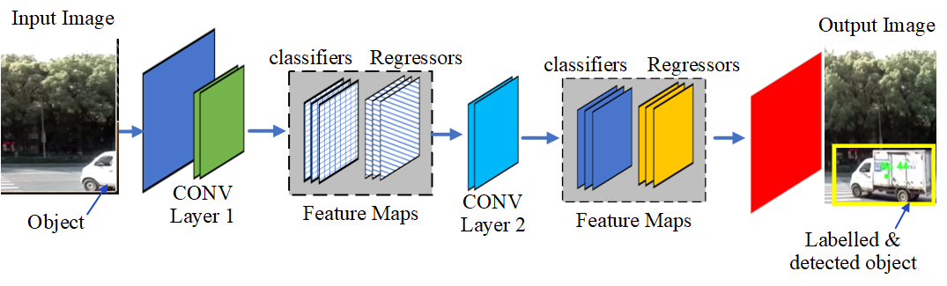
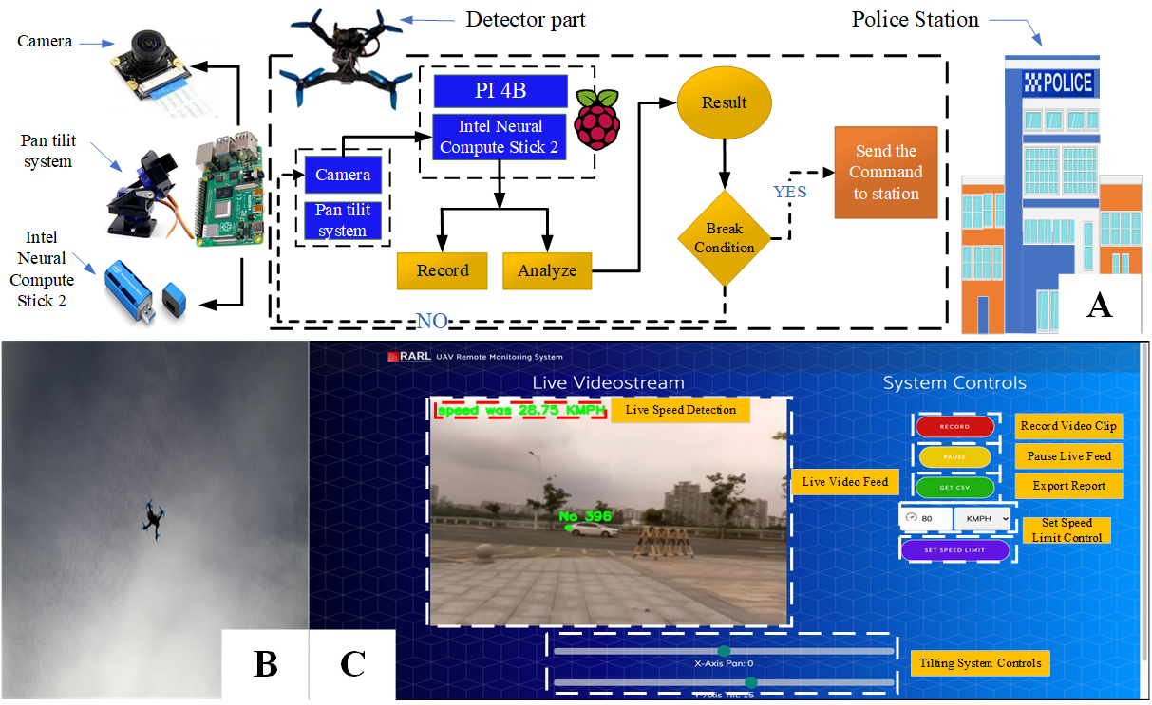
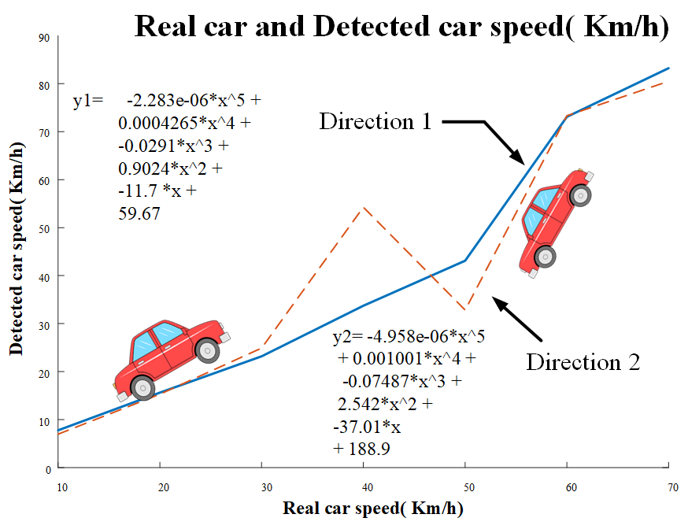
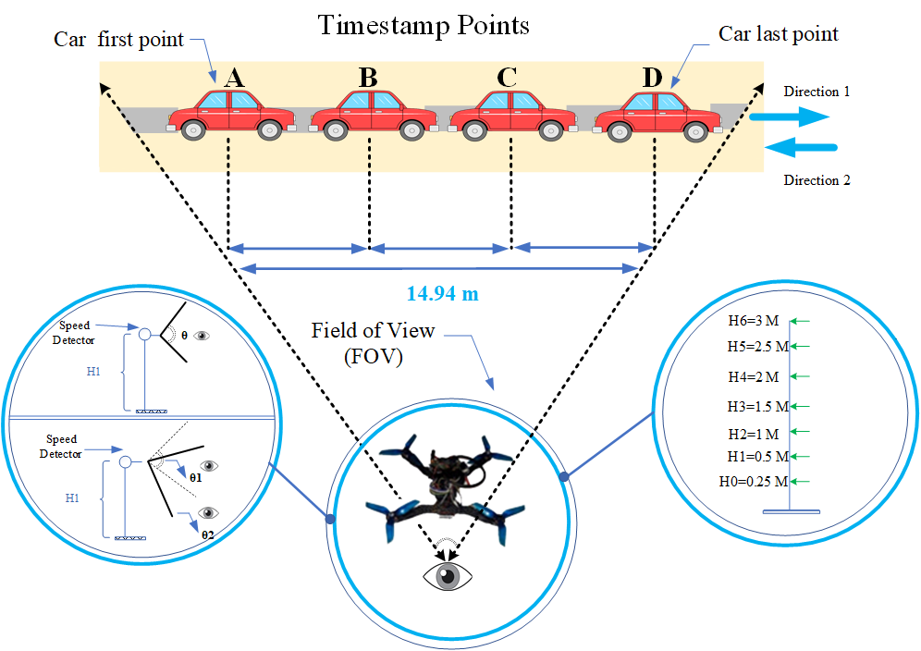

Remote Police
A Secure Traffic Police Remote Sensing Approach via a
Deep Learning-Based Low-Altitude Vehicle Speed Detector through UAVs in Smart Cites
INTRODUCTION
This Project introduces a novel low-altitude UAV-based vehicle speed detection system designed for smart cities. The system aims to enhance traffic safety and security by providing real-time speed detection. Key aspects of the research include:
1. Camera Optimization : Identified the optimal field of view (FOV) for a Raspberry Pi camera in various indoor and outdoor scenarios by adjusting height and angle.
2. Deep Learning Integration : Implemented Mobile Net-SSD deep learning model parameters on a Raspberry Pi 4B processor to detect vehicle speeds at different speeds.
3. Field Testing : Deployed the system at JXUST university intersection, varying UAV height (0.7 to 3 meters) and camera angle to assess performance.
The system utilizes a Raspberry Pi 4B and Intel Neural Compute Stick 2 with a Mobile Net-SSD model for intelligent speed detection. It offers an effective alternative to fixed cameras, especially in hard-to-access areas. Experimental results demonstrate the system’s superior performance in dynamic environments, such as crowded roads near schools and hospitals, providing accurate speed detection and enhancing smart city traffic management.
CONCLUSIONS
In this project, we have proposed a novel solution using extended UAVs, an application of remote sensing, to improve IoT-based smart city services. To show its superior performance, several different indoor and outdoor scenarios have been evaluated through implementation. The superior performance mainly stems from the accurate calibration of the UAV’s camera, obtained in one of the implemented scenarios, supporting accurate vehicle speed detection. The results show that vehicle detection error reduces when the UAV height increases. Specifically, by increasing the UAV height, vehicles’ separations are decreased, facilitating the easier detection of sudden speed changes in vehicles. Even in the case of connecting roads, such as the location of traffic lights, the car’s speed generally varies, and sudden changes cause interference in the measurement of the actual speed, but the promising results of the solution elaborate on its effectiveness in crowded roads or junctions where vehicles have variant and non-stable speeds. In addition, our solution has the capability to connect to the traffic police with a friendly and easy-use GUI, which can handle the data and helps the end-users in the smart city to control the camera and record. In future work, we aim to evaluate it using the three different angles (yaw, pitch, roll) along with implementing other deep learning methods and comparing the measured system speed result with the city police control traffic cameras for better calibration and evaluation. It is also planned to check and average the vehicle’s speed based on job distribution and a swarm of UAVs
Published result
Moshayedi, A. J., Roy, A. S., Taravet, A., Liao, L., Wu, J., & Gheisari, M. (2023). A secure traffic police remote sensing approach via a deep learning-based low-altitude vehicle speed detector through uavs in smart cites: Algorithm, implementation and evaluation. Future transportation, 3(1), 189-209.

Slide 6
Remote Police 远程警务
一种通过低空无人机车辆速度检测器在智慧城市中实现安全交通警察遥感的方法，基于深度学习技术
INTRODUCTION
本项目介绍了一个新颖的低空无人机(UAV)车辆速度检测系统，专为智慧城市设计。该系统旨在通过提供实时速度检测来增强交通安全和安保。研究的主要方面包括：
摄像头优化：通过调整高度和角度，确定了Raspberry Pi摄像头在各种室内和室外场景中的最佳视野(FOV)。
深度学习集成：在Raspberry Pi 4B处理器上实现了Mobile Net-SSD深度学习模型参数，以检测不同速度下的车辆速度。
现场测试：在JXUST大学交叉口部署系统，通过改变无人机高度（0.7到3米）和摄像头角度来评估性能。
该系统利用Raspberry Pi 4B和Intel Neural Compute Stick 2，并结合Mobile Net-SSD模型进行智能速度检测。它为固定摄像头提供了一种有效的替代方案，特别适用于难以到达的区域。实验结果表明，该系统在动态环境（如学校和医院附近的繁忙道路）中表现优异，提供了准确的速度检测，增强了智慧城市的交通管理。
CONCLUSIONS
在本项目中，我们提出了一种使用扩展无人机(UAV)的创新解决方案，这是一种遥感应用，旨在改善基于物联网(IoT)的智慧城市服务。为了展示其优越性能，通过在多种室内和室外场景中的实施进行了评估。其优越性能主要源于在其中一个实施场景中无人机摄像头的精确校准，支持准确的车辆速度检测。结果表明，当无人机高度增加时，车辆检测误差减少。具体来说，通过增加无人机高度，车辆之间的间隔减少，便于检测车辆速度的突然变化。即使在连接道路（如交通灯位置），车辆速度通常会变化，突然变化会干扰实际速度的测量，但解决方案的有前景结果详细说明了其在车辆速度变化和不稳定的繁忙道路或交叉口的有效性。
此外，我们的解决方案具有连接交通警察的能力，配备了友好且易用的GUI，能够处理数据并帮助智慧城市的最终用户控制摄像头和记录。在未来的工作中，我们计划使用三个不同的角度（偏航、俯仰、滚转）进行评估，并实现其他深度学习方法，比较测量系统速度结果与城市警察控制交通摄像头，以进行更好的校准和评估。同时还计划基于任务分配和无人机群的方式检查和平均车辆速度。
Published result
Moshayedi, A. J., Roy, A. S., Taravet, A., Liao, L., Wu, J., & Gheisari, M. (2023). A secure traffic police remote sensing approach via a deep learning-based low-altitude vehicle speed detector through uavs in smart cites: Algorithm, implementation and evaluation. Future transportation, 3(1), 189-209.

Slide 7





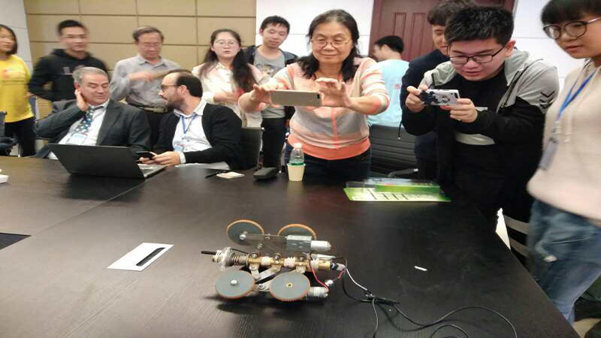
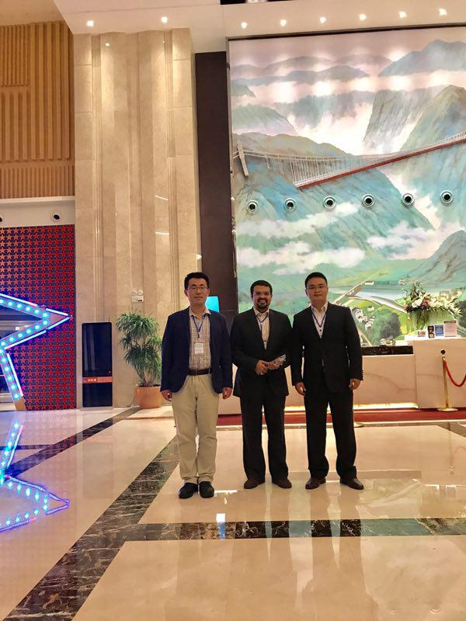


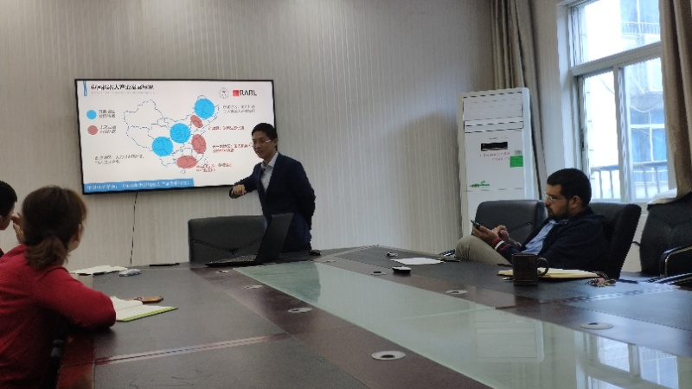

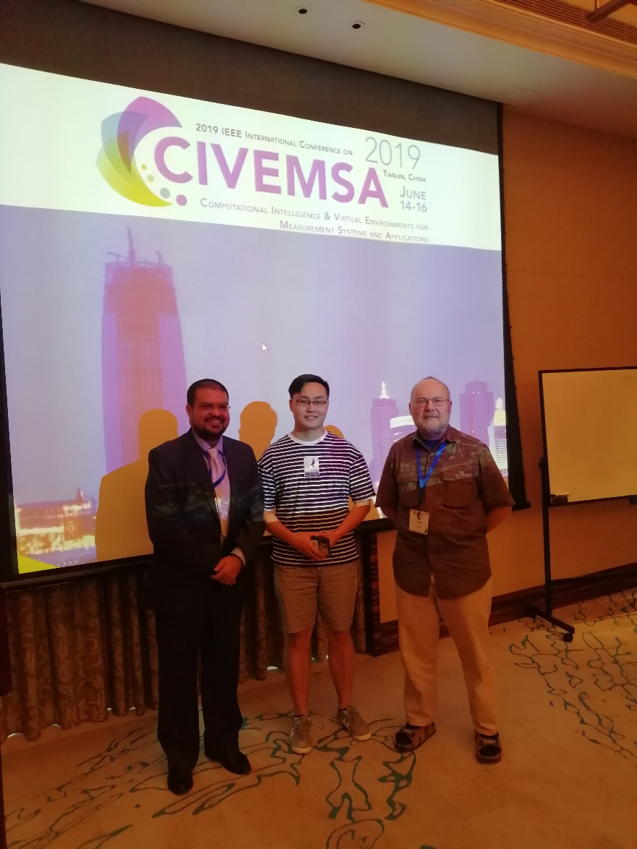
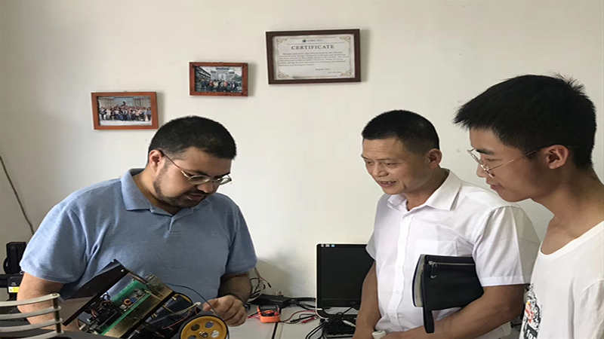

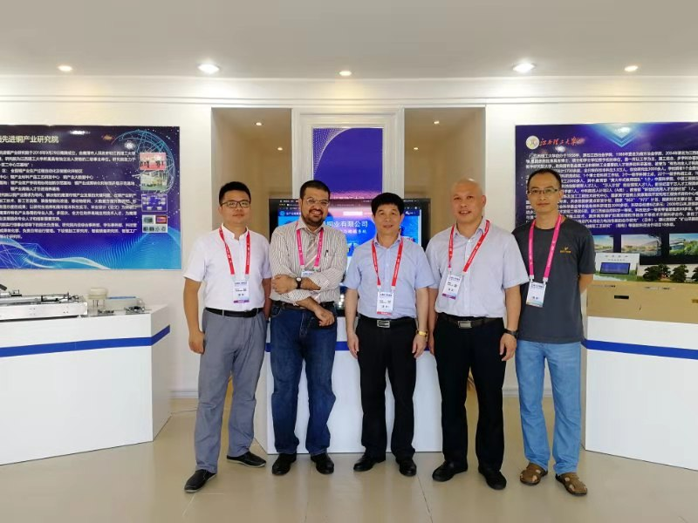

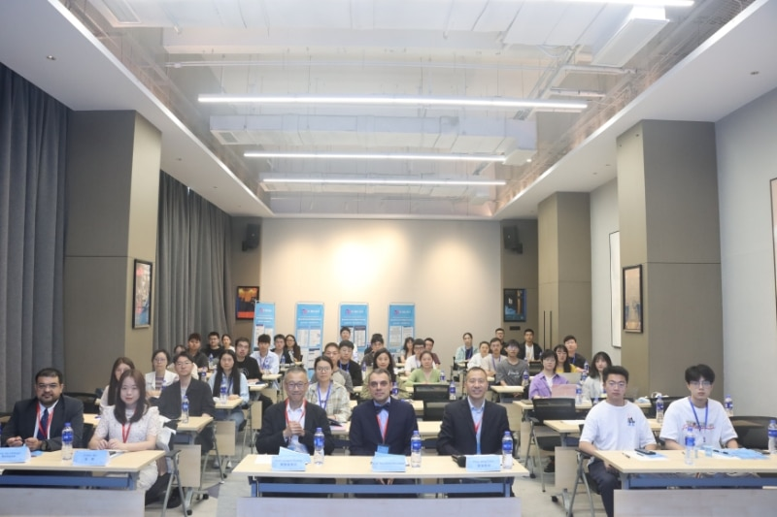
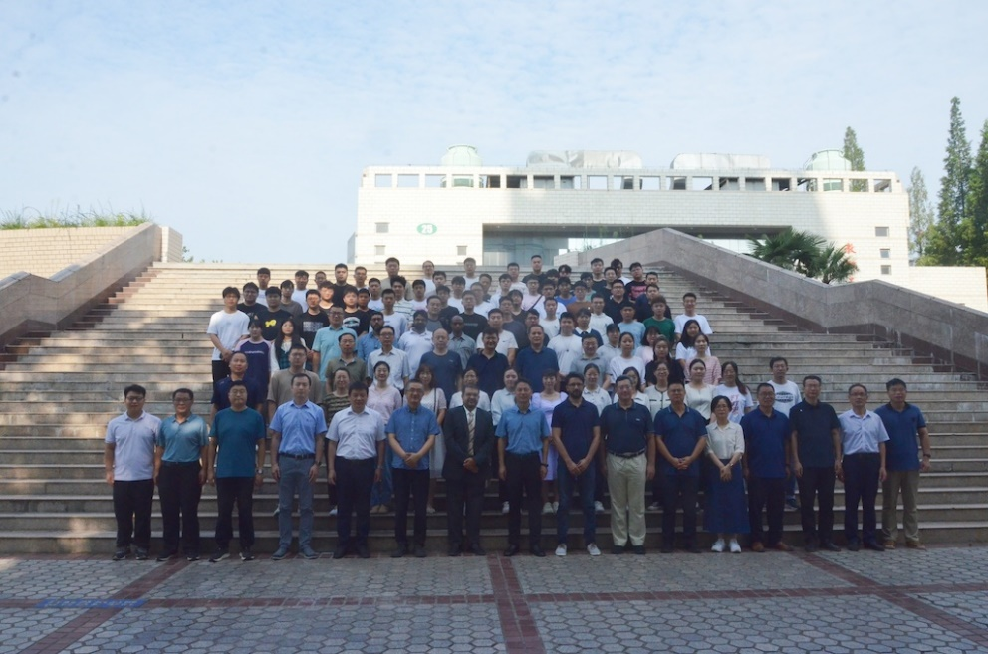
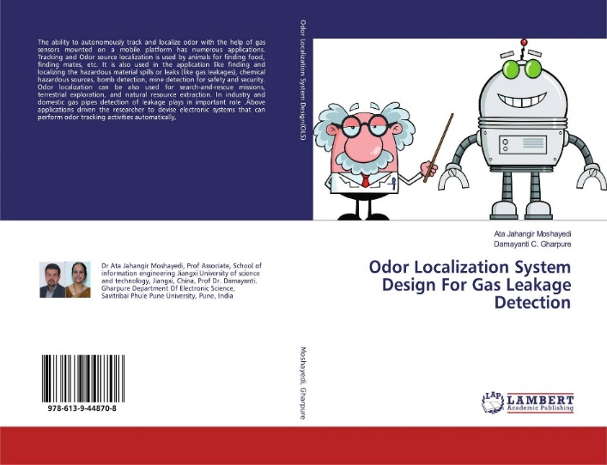
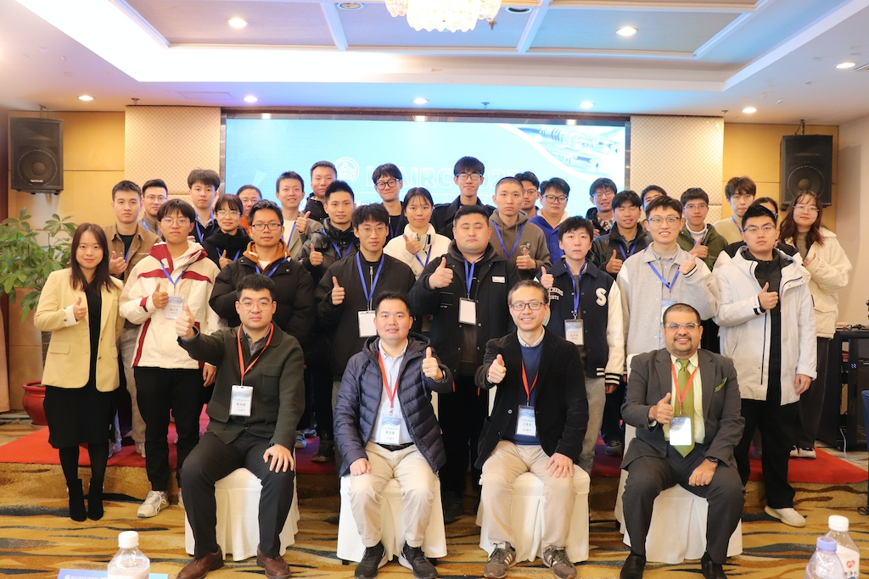
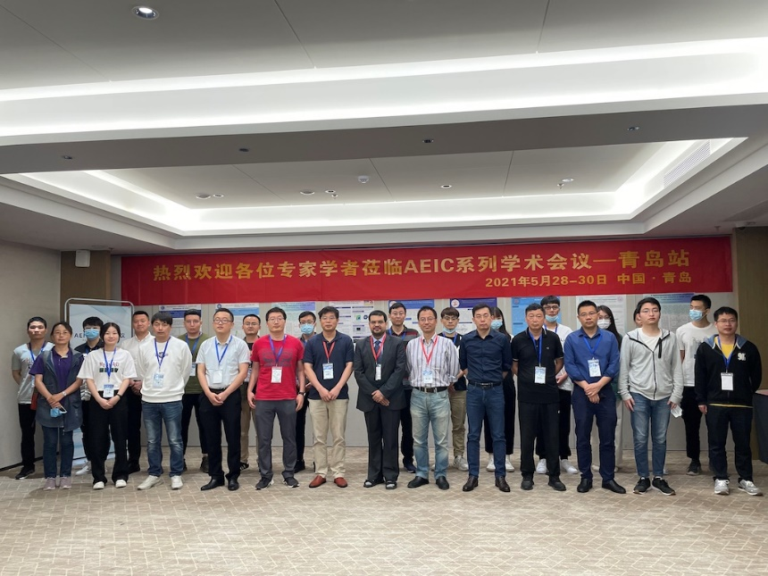
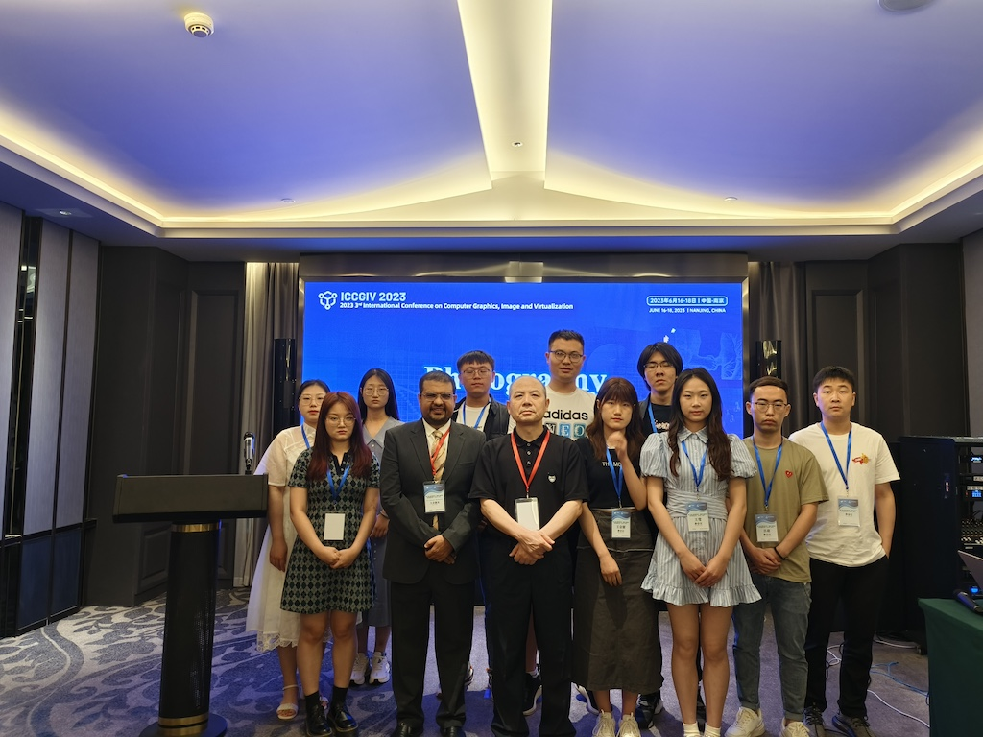
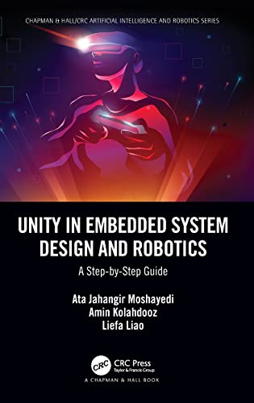
Robotics And Research Automaton Lab (RARL]
RESULTS
Welcome To RARL
This centre is started to develop design and various robot specially in the filed of service robot and active in automation project. The main target over than research in this filed is consulting and help industry for automation solution.
7
2019
2022

Slide 9

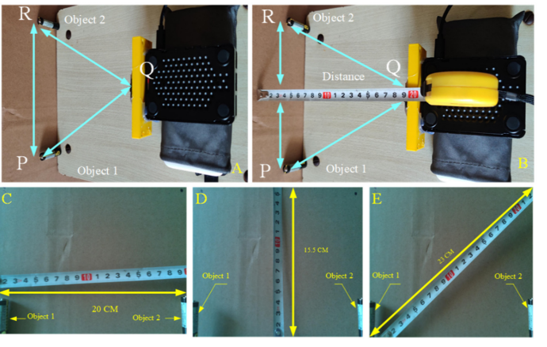
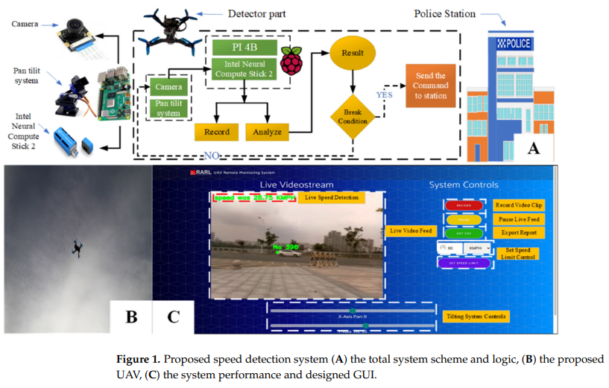
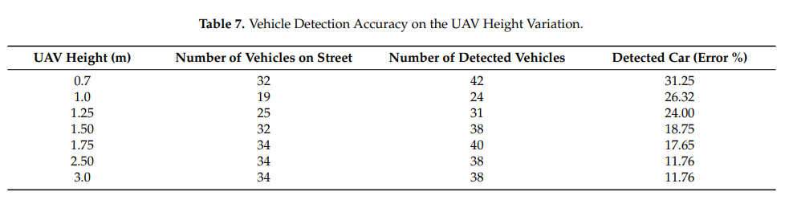


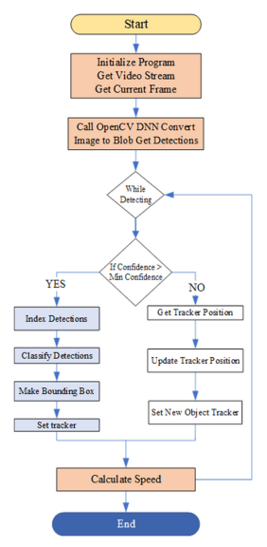
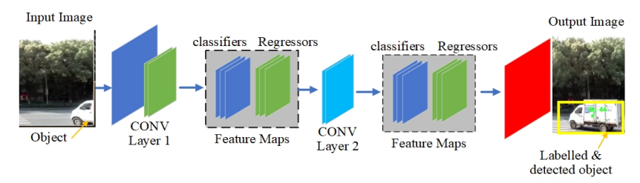
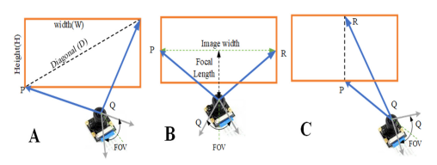
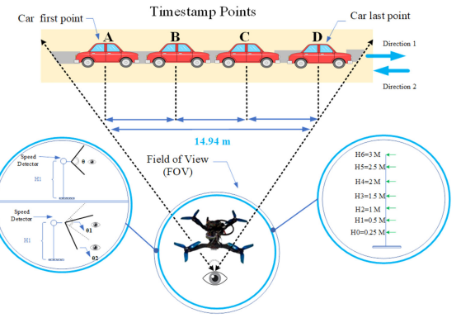

A Secure Traffic Police Remote Sensing Approach via a Deep Learning-Based Low-Altitude Vehicle Speed Detector through UAVs in Smart Cites
Abstract
INTRODUCTION
This paper presents a novel deep learning-based system for real-time vehicle speed detection using low-altitude unmanned aerial vehicles (UAVs) in smart cities. The system employs a MobileNet-SSD deep learning model embedded on a Raspberry Pi 4B processor and Intel Neural Compute Stick 2 for edge-based vehicle detection and speed estimation. The authors evaluated the performance of the proposed system by conducting experiments at different UAV heights (0.7 to 3 meters) and camera angles, demonstrating its effectiveness in accurately detecting and estimating the speeds of vehicles, especially in dynamic and crowded scenarios such as intersections near schools and hospitals. The results show the superiority of the proposed UAV-based system over existing approaches, making it a promising solution for improving traffic safety and security in future smart cities.
Unmanned aerial vehicles (UAVs) have gained significant attention in various remote sensing applications, including transportation management. One such application is the use of UAVs for real-time vehicle speed detection, which can contribute to enhanced traffic safety and security in smart cities. However, most existing vehicle speed estimation methods lack the ability to provide accurate and reliable detection in different situations and scenarios.
To address this gap, this study introduces a novel low-altitude vehicle speed detector system using UAVs for remote sensing applications in smart cities. The proposed system leverages a deep learning-based approach, specifically the MobileNet-SSD model, to detect and estimate the speeds of vehicles. The system is implemented on a Raspberry Pi 4B processor and Intel Neural Compute Stick 2, providing edge-based processing capabilities.
DISCUSSION
RESULTS
The results show the superiority of the UAV-based system over traditional fixed cameras and police officers for real-time vehicle speed monitoring in smart cities. The edge-based processing capabilities and deep learning-powered detection and estimation enable reliable performance even in dynamic traffic conditions. The system's ability to be deployed at low altitudes provides flexibility and reduces privacy concerns compared to higher-altitude UAV solutions. Further research is needed to evaluate the system's performance at larger scales and under varying weather/lighting conditions.
he proposed UAV-based system outperformed existing approaches, demonstrating high effectiveness in accurately detecting and estimating vehicle speeds, especially in crowded areas like intersections near schools and hospitals.
CONCLUSIONS
The proposed UAV-based deep learning system provides a secure and reliable solution for real-time vehicle speed monitoring in smart cities. Key advantages include:
1. Improved accuracy and reliability: The system demonstrated superior performance in detecting and estimating vehicle speeds, especially in crowded, dynamic traffic conditions where traditional methods struggle.
2. Edge-based processing capabilities: Embedding the deep learning model on the Raspberry Pi 4B and Intel Neural Compute Stick 2 enables real-time, on-board processing and inference, avoiding the latency and security issues of cloud-based approaches.
3. Flexible low-altitude deployment: The ability to operate the UAV at low heights (0.7 to 3 meters) provides flexibility in deployment and reduces privacy concerns compared to higher-altitude UAV solutions.
4. Improved traffic safety and security: By accurately monitoring vehicle speeds, the system can help enforce speed limits, identify reckless driving, and enhance overall traffic safety and security in smart cities.
This innovative UAV-based deep learning system overcomes the limitations of existing vehicle speed estimation methods, offering a promising solution to support intelligent transportation management and improve quality of life in smart urban environments.
METHODS AND MATERIALS
The system used a Raspberry Pi 4B processor and Intel Neural Compute Stick 2 as the edge computing hardware, with the MobileNet-SSD deep learning model embedded for real-time vehicle detection and speed estimation.
The researchers optimized the camera's field of view by testing different UAV heights (0.7 to 3 meters) and camera angles in both indoor and outdoor scenarios.
For real-world evaluation, the system was deployed at a university intersection, testing the same range of UAV heights and camera angles. Vehicle speed estimates were compared against ground truth measurements from a laser gun.
Published result
QR
QR

Slide 10
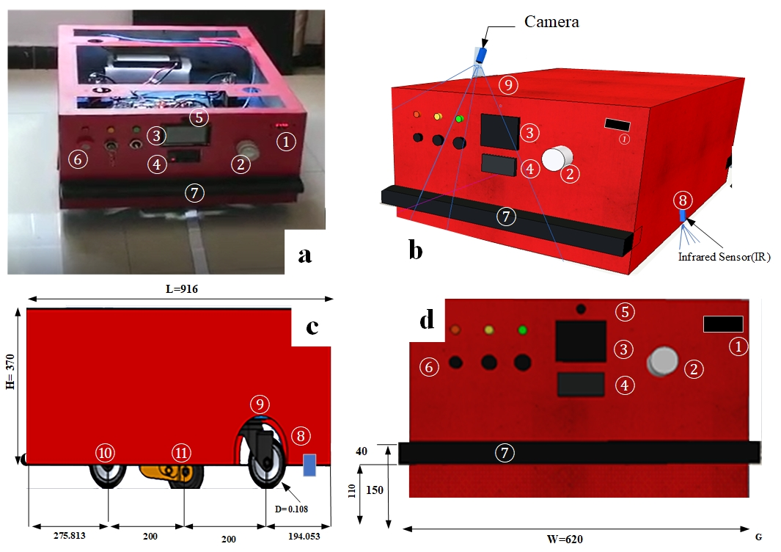

INTRODUCTION
Click here to insert your Introduction text. Type it in or copy and paste from your Word document or other source. Click once on the dashed border to highlight then drag the bottom edge up to fit. Or change the font size to fill the box.
To have the box automatically re-size to your text: Double-click near the edge to open the Format tool, and select ‘Text Box’, then check “Resize AutoShape to Fit Text”.
To change the background color of this text box: Double-click near the edge to open the Format tool, select ‘Colors and Lines’, and change the fill color to whatever you like.
The various elements and text boxes included in this template are examples of what we commonly see on posters of this kind. They are simply placeholders and you should feel free to add, delete, re-arrange, re-name, or re-size as best suits your needs.
ABSTRACT
Click here to insert your Abstract text. Type it in or copy and paste from your Word document or other source.
This text box will automatically re-size to your text.
To change the background color of this text box: Double-click near the edge to open the Format tool, select ‘Colors and Lines’, and change the fill color to whatever you like.
To change the font style of this text box: Click on the border once to highlight the entire text box, then select a different font or font size that suits you. This text is in Arial 22pt and is easily readable up to 3 feet away in a 24x48 poster, and up to 6 feet away in a 48x96 poster (file printed at 200%).
RESULTS
Click here to insert your Introduction text. Type it in or copy and paste from your Word document or other source. Click once on the dashed border to highlight then drag the bottom edge up to fit. Or change the font size to fill the box.
To have the box automatically re-size to your text: Double-click near the edge to open the Format tool, and select ‘Text Box’, then check “Resize AutoShape to Fit Text”.
To change the background color of this text box: Double-click near the edge to open the Format tool, select ‘Colors and Lines’, and change the fill color to whatever you like.
The various elements and text boxes included in this template are examples of what we commonly see on posters of this kind. They are simply placeholders and you should feel free to add, delete, re-arrange, re-name, or re-size as best suits your needs.
DISCUSSION
Click here to insert your Introduction text. Type it in or copy and paste from your Word document or other source. Click once on the dashed border to highlight then drag the bottom edge up to fit. Or change the font size to fill the box.
To have the box automatically re-size to your text: Double-click near the edge to open the Format tool, and select ‘Text Box’, then check “Resize AutoShape to Fit Text”.
To change the background color of this text box: Double-click near the edge to open the Format tool, select ‘Colors and Lines’, and change the fill color to whatever you like.
The various elements and text boxes included in this template are examples of what we commonly see on posters of this kind. They are simply placeholders and you should feel free to add, delete, re-arrange, re-name, or re-size as best suits your needs.
Published result
Video
Ferrández-Pastor, Francisco, et al. "Developing ubiquitous sensor network platform using internet of things: Application in precision agriculture." Sensors 16.7 (2016): 1141
Gondchawar, Nikesh, and R. S. Kawitkar. "IoT based smart agriculture." International Journal of advanced research in Computer and Communication Engineering 5.6 (2016): 838-842
Krishna, K. L., Silver, O., Malende, W. F., & Anuradha, K. (2017). Internet of Things application for implementation of smart agriculture system. 2017 International Conference on I-SMAC (IoT in Social, Mobile, Analytics and Cloud) (I-SMAC). doi:10.1109/i-smac.2017.8058236
P. J. Sarkar and S. Chanagala, “IoT based Digital Agriculture Monitoring System & Their Impact on Optimal Utilization of Resources,” J. Res. Vol., vol. 4, no. 01, pp. 1–4, 2018
QR
QR

Slide 11
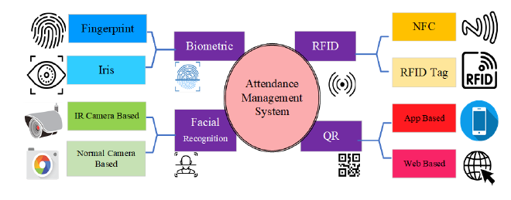
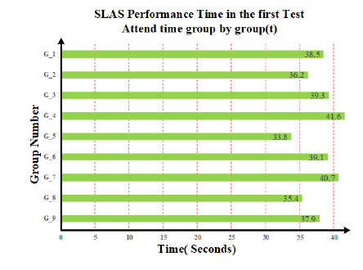
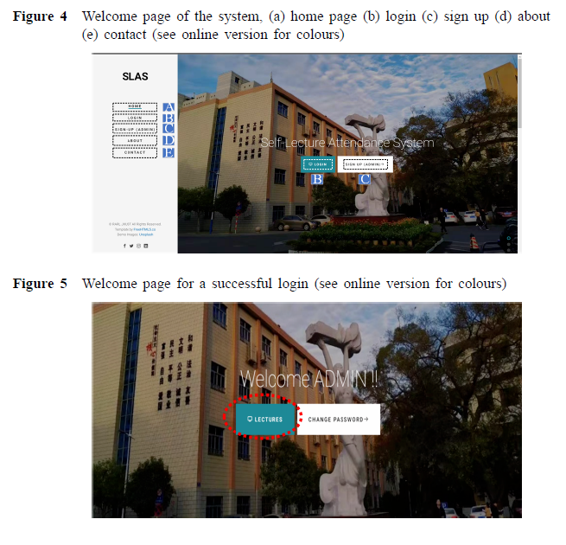
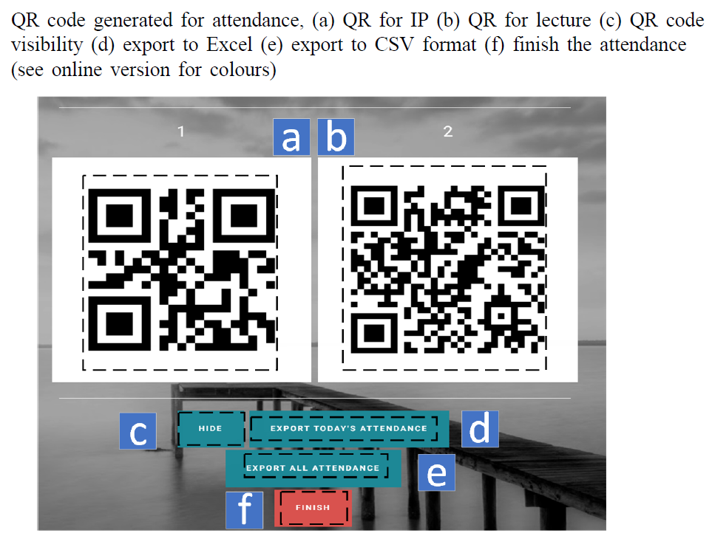
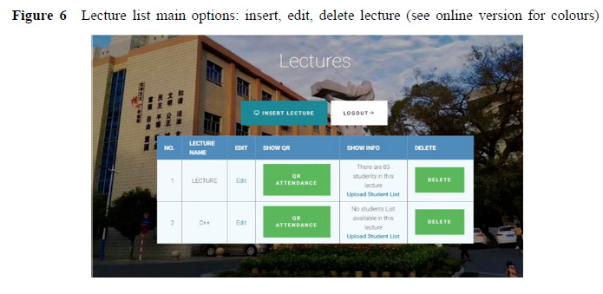
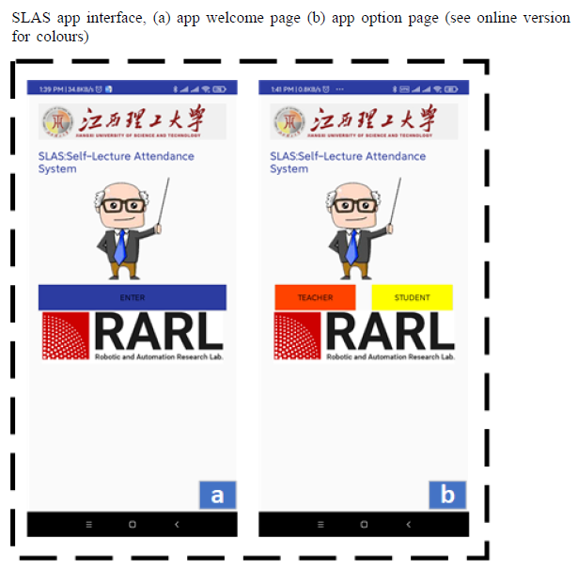
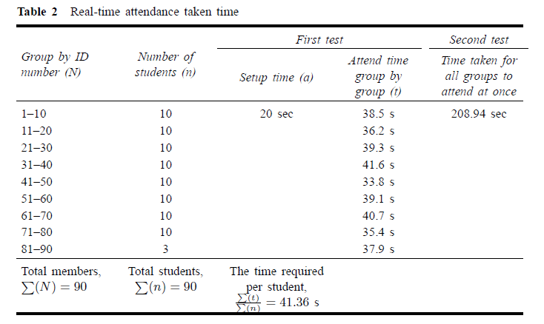
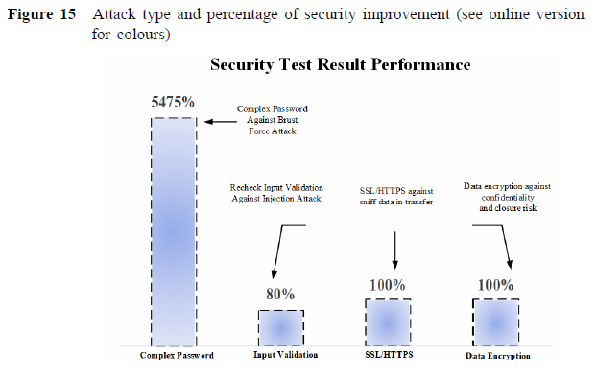



A novel IoT-enabled portable, secure automatic
self-lecture attendance system: design,
development and comparison
Abstract
INTRODUCTION
This study focuses on the importance of monitoring student
attendance in education and the challenges faced by educators in doing so. Existing methods for attendance tracking have drawbacks, including high costs, long processing times, and inaccuracies, while security and privacy concerns have often been overlooked. To address these issues, the authors present a novel internet of things (IoT)-based self-lecture attendance system (SLAS) that leverages smartphones and QR codes. This system effectively addresses security and privacy concerns while providing streamlined attendance tracking. It offers several advantages such as compact size, affordability, scalability, and flexible features for teachers and students.Empirical research conducted in a live lecture setting demonstrates the efficacy and precision of the SLAS system. The authors believe that their system will be valuable for educational institutions aiming to streamline attendance tracking while ensuring security and privacy.
The Self-Lecture Attendance System (SLAS) is a novel IoT-enabled solution designed to streamline student attendance management in educational institutions. Traditional methods like biometric, RFID/NFC, and QR code systems face challenges such as high costs, environmental dependencies, and security concerns. SLAS overcomes these limitations by integrating dynamic QR codes with cloud-based processing, ensuring fast, secure, and cost-effective attendance tracking. It enhances security, supports multiple users, and is scalable for institutions of all sizes. With improved efficiency and accessibility, SLAS offers a modern, reliable alternative to traditional attendance systems.
DISCUSSION
RESULTS
The SLAS system streamlines attendance tracking with a secure web and mobile app, utilizing Java, MySQL, and Android for efficient operation. The web app acts as the server, while the mobile app allows students to scan QR codes for attendance. Security features like complex passwords, SSL/HTTPS encryption, and data encryption protect user data. The system’s database structure handles lecture and attendance records, with teachers able to export data in CSV format for analysis. Results show that the system enhances efficiency in classroom management, providing a smooth, automated attendance process for both teachers and students.
SLAS booted in 55 ± 5 seconds and completed attendance in 204 seconds (lab) / 209 seconds (classroom). Each student took 41.36 seconds on average. The system proved efficient, cost-effective, and user-friendly. Security measures, including stronger passwords, input validation, and asymmetric encryption, significantly improved resistance against attacks. Penetration tests identified vulnerabilities like weak Wi-Fi encryption and short passwords, which were addressed with recommended fixes.
METHODS AND MATERIALS
The SLAS IoT-enabled solution consists of a Raspberry Pi 3B+ as the primary hardware, connected via Wi-Fi to a router for communication, and an Android-based mobile application. The system ensures security using SSL certificates, HTTPS, and WPA2 encryption. The software includes a web-based service and a mobile app developed in Java and Android Studio, with a MySQL database and an MVC architecture for modular deployment. Teachers use the web interface to generate dynamic QR codes, while students scan them using the mobile app to register attendance. The server verifies entries through token-based authentication, updating records in real time. SLAS enhances accuracy, security, and scalability, offering a modern, automated alternative to traditional attendance systems.
CONCLUSIONS
The proposed attendance system based on IoT provides the following key advantages:
Cost-effective & Portable: SLAS integrates IoT and cloud computing, eliminating the need for expensive hardware or software modifications.
Fast & Efficient: Attendance verification for 83 students is completed in approximately three minutes.User-Friendly: Compact, easy to use, and nearly plug-and-play with an intuitive GUI.
Security & Privacy: Enhanced protection for teachers and students, with plans for multi-factor authentication (MFA).
Future Improvements: Expansion to iOS and integration of facial and emotion recognition for student engagement assessment.
Ideal for Education: A scalable, efficient, and low-cost solution for educational institutions.
This innovative attendance system overcomes the limitations of existing methodologies and provides a highly efficient, secure, and cost-effective solution for educational institutions.
Published result
Moshayedi, Ata Jahangir, et al. "A novel IoT-enabled portable, secure automatic self-lecture attendance system: design, development and comparison." International Journal of Electronic Security and Digital Forensics 16.6 (2024): 663-689.

Slide 12







EMTIHAN: Design of a novel approach to secure online examination challenge in remote learning
Abstract
INTRODUCTION
In this paper, a secure exam proctoring assistant ‘EMTIHAN’ (which means exam in Arabic/Persian Urdu/Turkish languages) is developed to address concerns related to online exams for handwritten topics by allowing students to submit their answers online securely via their mobile devices. This system is designed with an aim to lessen the student’s burden of exam submission by offering portable hardware and easy-to-use cloud infrastructure. The main contribution of this research is to design an innovative system for online examination (in remote or distance learning scenarios) and using mixed methods i.e. both quantitative and qualitative data collection and analysis to verify its performance. The comparative results regarding submission time and security features have proven the efficacy of EMTIHAN against manual submission with participants across 5 countries using purposive sampling and currently available solutions e.g. Chaoxing MOOC and Google Classroom with 94.5% student satisfaction rate. Furthermore, app scan quality is measured using structural similarity index measure comparing with popular CamScanner app showing better quality despite image compression.
The COVID-19 pandemic disrupted education globally, leading to the rapid adoption of online learning and exam systems. However, online exams face challenges such as security, time management, and digital literacy, especially for science and engineering courses requiring handwritten assessments. Existing systems primarily support MCQs and short answers but lack robust solutions for secure, handwritten submissions. EMTIHAN, a proposed framework, addresses these gaps by ensuring information preservation, high-quality data transfer, and secure proctoring using IoT, blockchain, and 5G/6G technologies. Unlike previous systems, EMTIHAN facilitates handwritten exam uploads in real-time and enhances security with multi-factor authentication and AI-driven monitoring.
RESULTS
METHODS AND MATERIALS
The EMTIHAN testing involved a multi-step evaluation of the app's performance, quality, and usability. Test Set 1 analyzed the time from app installation to paper submission, showing that EMTIHAN allowed students to submit a five-page paper in 3.14 minutes, nearly twice as fast as the manual method, which took about 6 minutes. Test Set 2 compared manual submission, where students converted images to PDF and submitted via WeChat. EMTIHAN was significantly faster, averaging 3.14 minutes, compared to 6 minutes for the manual method.
The methodology of the EMTIHAN system involves two main components: hardware and software, working together to digitize and manage handwritten exam submissions. Teachers interact with a web-based platform to upload exam papers, set time limits, generate QR codes for student submissions, and track exam progress. The mobile app, used by students, allows them to scan their handwritten exam papers, convert them into PDFs, and upload them using QR codes. The system utilizes Raspberry Pi for hosting, a wireless router for connectivity, and an Android smartphone for the app. The software includes a PHP-based web portal for teacher management, while the mobile app is built using Android SDK and Kotlin to facilitate scanning and submission. The system ensures smooth data handling with session management, user authentication, and storage, while employing image processing techniques like cropping, rotating, and applying filters to enhance scanned documents before uploading them to the server.
Test Set 3 assessed image quality, comparing EMTIHAN with CamScanner, a popular text-to-PDF app. Test Set 4 demonstrated EMTIHAN's ability to handle submissions from students in various countries without data corruption, with only a 2-minute delay. Finally, Test Set 5 showed that EMTIHAN significantly reduced submission time compared to manual methods, improving efficiency without affecting submission accuracy.
The app employs a custom image enhancement filter using OpenCV, grayscale conversion, and color handling to improve visibility and accuracy. It integrates file processing utilities, including PDF creation, and an upload service supporting features like concurrent uploads, retry mechanisms, notifications, and progress tracking. The system operates on a client-server architecture, ensuring scalability and efficiency with asynchronous task processing and background optimization for reliable performance.
CONCLUSIONS
This work addresses challenges in online handwritten exams and proposes the EMTIHAN proctored exam system, designed to overcome these issues. EMTIHAN utilizes a Raspberry Pi 3B+ for portability and integrates features like handwriting support, automatic PDF conversion, encryption, and secure file handling. It offers smooth global accessibility, mobile compatibility, and multiple language support, with easy integration into existing systems. Compared to traditional manual submission, EMTIHAN significantly reduces submission time and improves image quality. The system is also more effective than other solutions like Chaoxing MOOC and GCR, with a 94.5% popularity rating. Future work includes optimizing image scanning with OCR, improving LaTeX conversion, and expanding device compatibility to reduce limitations such as the need for a stable internet connection and specific hardware requirements.
Published result
Moshayedi, A.J., Roy, A.S., Khan, Z.H. et al. EMTIHAN: Design of a novel approach to secure online examination challenge in remote learning. Educ Inf Technol (2024). https://doi.org/10.1007/s10639-024-13170-4

